Slide 1
Different types of Machine learning System

Slide 2
Types of Machine Learning System
Regression
Supervised Learning
Classification
Traditional
System
Machine Learning
Unsupervised Learning
Reinforcement Learning

Slide 3
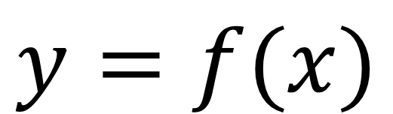
Supervised Learning
Label
Predict
Function f
Traditional
System
Input Data

Slide 4
Supervised Learning
Data
Supervised Learning
Model

Slide 5

Regression (Predicting house price)
Size (in square foot) = X | Price = Y
2104 | 399900
1600 | 329900
2400 | 369000
1416 | 232000
3000 | 539900
1985 | 299900
1534 | ???
Slope
Intercept
Price
Size
New Size

Slide 6
Classification
In regression All output values are continuous
While in classification all output value are discrete.

Slide 7
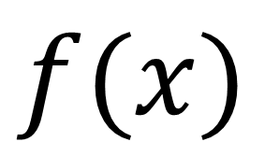
Unsupervised learning
Model
Function f
Traditional
System
Input Data

Slide 8
Unsupervised Learning

Slide 9


Summary
 | Input Given | Output Given | Output
Regression |  |  | Continuous
Classification |  |  | Discrete
Unsupervised Learning |  |  | Cluster

Slide 10
Thank You

